Slide 1
Social Media in Coursework
FOTL Conference
January 12, 2022
Anna Press
apress@luc.edu
School of Education

Slide 2
Introduction
International graduate student in the School of Education as of Fall 2020
Taught one section of a four-section Educational Policy class Fall 2021 at LUC
Classwork included a “Policy Pulse” assignment incorporating social media
You’re welcome to ask questions & share comments in the chat too

Slide 3
Overview
Context: In person and online – synchronous and asynchronous
Approach: Incorporate Social Media meaningfully
Outcome: Student-led collaboration and policy understanding
Reflection & Tips

Slide 4
Key Context Considerations
Undergraduate students training to become teachers
First time taking a university class in person for some
Hybrid class delivery - both synchronous and asynchronous
Who?
What?
How?
Notes:
Who: Focus on learner needs and make the learning accessible. If incorporating social media, ask them which platforms they use and what they use them for. Learning should be applicable to their lives.
What: Consider what’s unique about the context you’re teaching in. For example, a number of my students hadn’t taken an in-person uni class before, so how does that impact course design?
How: Design the course with enough flexibility to adapt to in-person and online, but also synchronous and asynchronous sessions if need be e.g., maybe the assignment will go to voicethread with peer comments instead of in-person small group facilitated discussions

Slide 5
Overview of Approach
What?
Use social media as a means for students to engage with equity-oriented policy topics
How?
In pairs they chose the platform, post/tweet, mode of presentation & facilitated discussion, and summary format
Why?
Engage with social media/tech in new ways;
Collaborate with each other;
See educational policy through a more relevant lens – it’s crucial that the learning is applicable and actionable (social media feels familiar)
Notes:
Key points: (1) work with a partner to choose an engaging post, thread, forum or article (2) make sure it’s related to equity and educational policy, i.e., tied to what was touched upon in class (3) present a summary to classmates and then facilitate a small group class discussion about it (4) submit an academic summary to instructor

Slide 6
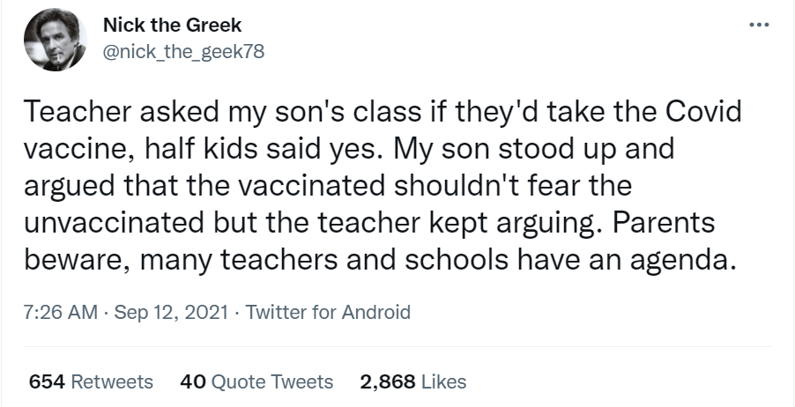
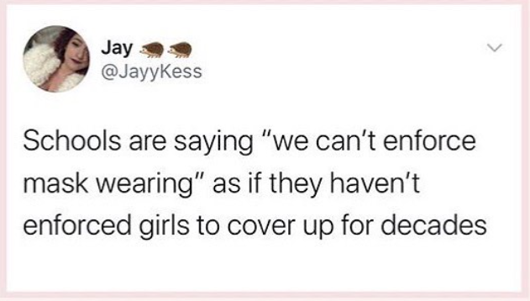
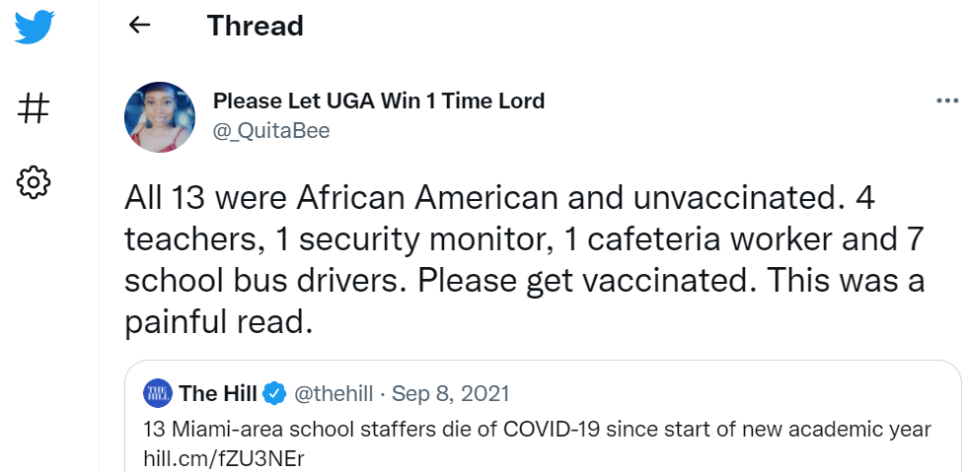
Example “Policy Pulse” Posts
Notes:
Student-chosen topics included: mask mandates, vaccine policies, dress code policies etc. and how they intersected with race, gender, socioeconomic status, etc. as well as levels of policy-making e.g., federal, state, etc.

Slide 7
Outcomes Students:
Described educational policy in contextually relevant ways
Demonstrated how social media can further social justice
Completed groupwork and shared experiences in meaningful ways

Slide 8
Reflections
A shared class document or initial survey could have helped avoid repeat topics
It was challenging for one instructor to monitor multiple presentations simultaneously online – instead you could record, have notetakers, only have one presentation at a time, etc.
It was beneficial that after each presentation we reflected jointly on what we had learned and appreciated in the presentations & discussions

Slide 9
Tips
Only incorporate social media if it contributes to the learning objectives
Stay flexible: assignments that adapt to asynchronous vs. synchronous contexts, e.g., facilitated discussions in break out rooms or peer reviewed presentations through Sakai-linked tools like Voicethread and Panopto
Make sure the learning, including tools, is accessible
Focus on equity – set class community guidelines and also ensure that the assignments incorporate Loyola’s social justice principles
Always consider your capacity!

Slide 10
Sample Assignment Ideas
Assignment | Field
Find a Tiktok or IG video about an idiom, grammatical construct, etc. and analyze it then create your own instructional video | Modern Languages
Compile 5 government communications about COVID-19 on social media then write an analytical report | Health Sciences
Prepare a presentation about social media platforms’ current data policies, including your recommendations for change citing congressional hearings, etc. | Political Science

Slide 11
Questions & answers
Thank you for your time!
apress@luc.edu

